Slide 1

Cbus Super Fund Risk Modelling Case
Prepared for Deloitte QFS Simulation

Slide 2
Executive Summary
This project simulates a Deloitte QFS client engagement to forecast drawdown risk and analyze portfolio VaR for Cbus Super Fund.
Predicts >5% drawdowns over 20 trading days using logistic regression.
Implements Parametric, Historical, and Monte Carlo VaR
Assesses diversified risk vs. single ETF risk profile

Slide 3
Business Problem
Super funds like Cbus exist to preserve and grow capital over decades, not chase short-term alpha. Their portfolios must support members‘ retirement needs 20 to 30 years into the future, making drawdown risk management far more critical than tactical gains. The client requires a data-driven solution to answer:
“Can we predict whether the portfolio will experience a drawdown of more than 5% over the next 20 trading days?”
“How good is diversified risk compared to single ETF risk profile?”
Deloitte Objective:
1) Predict >5% drawdowns in the next 20 days.
2) Implement VaR and ES to assess the risk of portfolio compared to single ETF.

Slide 4
Methodology
Drawdown Prediction Model (Classification-Based)
Target Variable: Binary flag if future 20-day return < -5%
Features: Rolling return volatility, momentum indicators, moving averages
Model: Logistic Regression
Validation: ROC-AUC and Confusion Matrix
VaR & Expected Shortfall Estimation (Risk Quantification)
Portfolio Composition: 7 ETFs diversified portfolio
VaR Models Implemented:
Confidence Level: 95%
Lookback period: 252 Days
Comparative Analysis: ETFs Portfolio vs. single ETF (IVV)
- Parametric (Variance-Covariance)
- Historical Simulation
- Monte Carlo Simulation

Slide 5

Model Evaluation: Drawdown Risk Forecasting
Model Results
The model identified 13 true drawdown events out of 13, with 46 false positives.
Sensitivity (Recall) = 100%, ensuring no major drawdown is missed.
Limitation: Higher false alarm rate. Can be tuned using decision thresholds or regularization techniques.
Business Insights
Model Captured all drawdowns, enabling early warning with confidence. For Cbus, the model prioritizes member protection with high sensitivity suitable. It also supports fiduciary standards proactive and explainable risk mitigation decisions

Slide 6
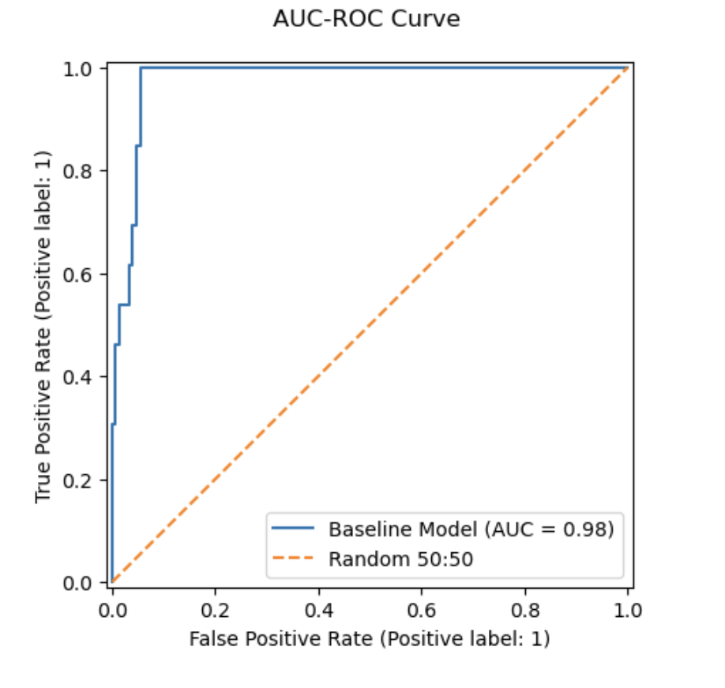
Visual Outputs
AUC of 0.98 indicates excellent predictive power.
Enables early detection of high-risk drawdown periods.
Supports Cbus’s need for timely de-risking and capital preservation.

Slide 7
VaR & ES Model Evaluation
Model Results
Portfolio VaR and ES under 95% confidence level
Business Insights
• Portfolio VaR < Single ETF VaR across all methods, which demonstrates effective diversification. • Confirms the portfolio is not overly exposed to any single risk factor. • Annualized risk metrics provide long-term insights aligned with superannuation governance and capital oversight.
Parametric VaR : -0.0118 → Annualized: 18.76%
Historical VaR : -0.0076
Monte Carlo VaR : -0.0077
Expected Shortfall : -0.0108
Annualized Parametric VaR: 18.76%
Single ETF (IVV) VaR and ES under 95% confidence level
Parametric VaR : -0.0175
Historical VaR : -0.0172
Monte Carlo VaR : -0.0176
Expected Shortfall : -0.0256

Slide 8
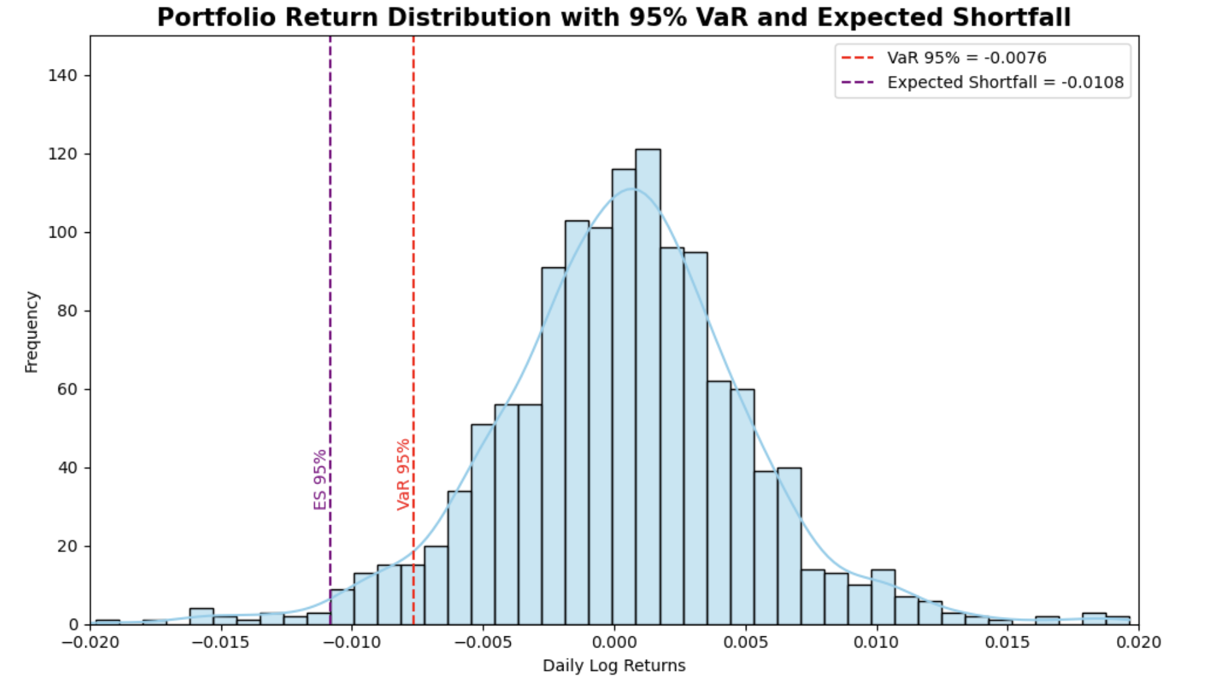
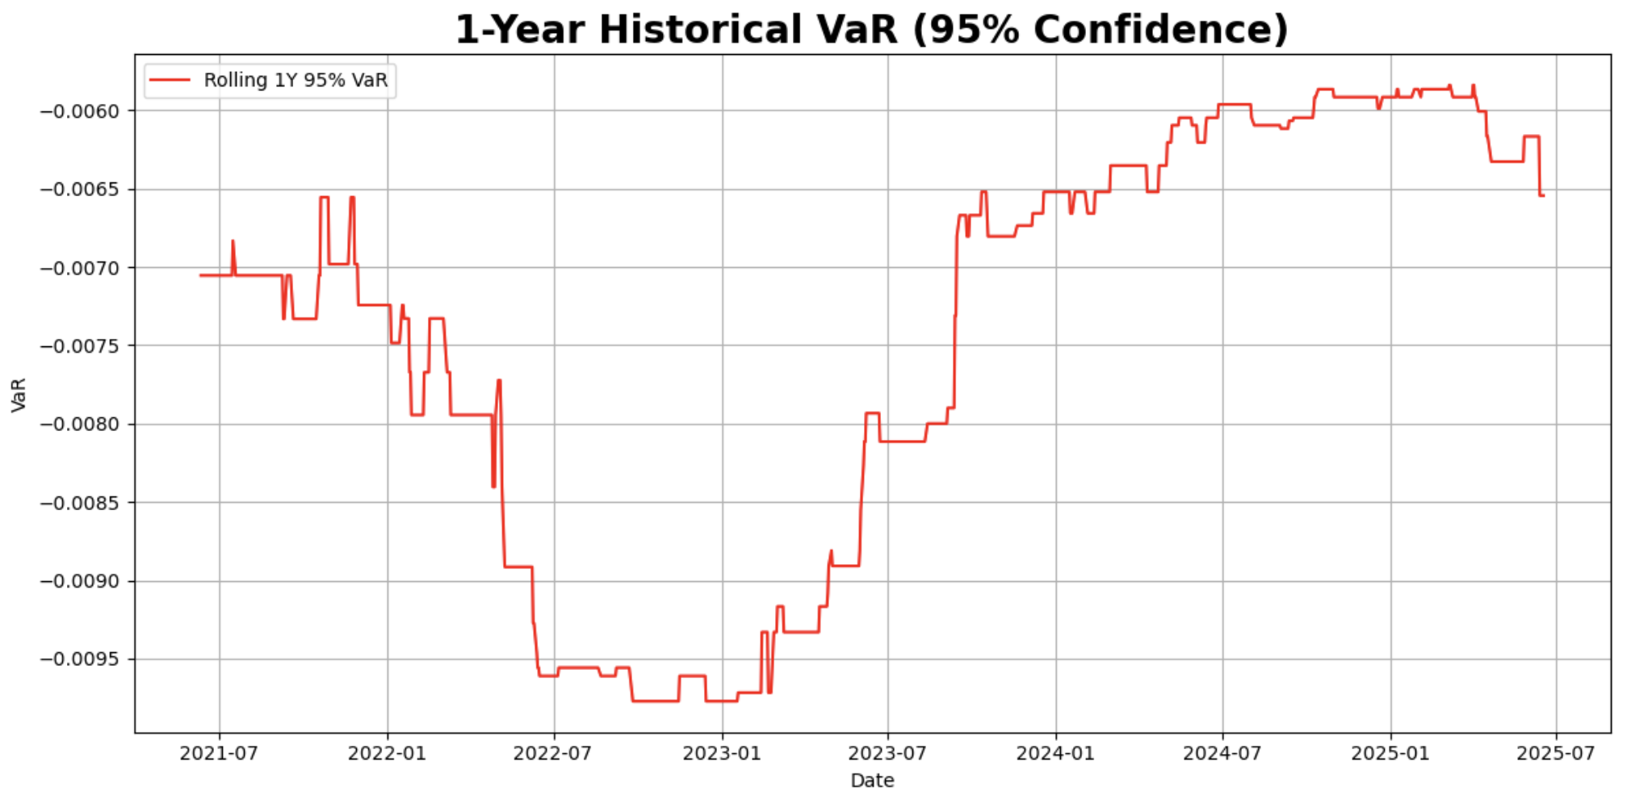
Visual Outputs

Slide 9
Summary & Alignment with Deloitte QFS
Developed a forward-looking risk solution that detects >5% drawdowns with high recall (100%) and AUC of 0.98.
Delivered diversified VaR analysis to demonstrate portfolio stability and quantify downside exposure.
Designed the model to support Cbus’s fiduciary responsibility: early intervention, transparent communication, and member-first protection.
This case shows how I bridge finance, mathematics, and client needs， which is, as a QFS analyst, delivers every day.

